Slide 1
CpE Qualifying Exam
Secondary paper: Machine learning
Threat of Adversarial Attacks on Deep Learning
in Computer Vision: A Survey
Naveed Akhtar, Ajmal Mian
IEEE Access 6, 2018.
Reviewed and presented by Jingyun Ning (jn2ne@virginia.edu)
CpE Ph.D. student
1

Slide 2
Outline
Introduction
Example of Adversarial Attacks
Real World Adversarial Attacks
Existence of Adversarial Attacks
Defenses of Adversarial Attacks
Conclusion and Review
2

Slide 3
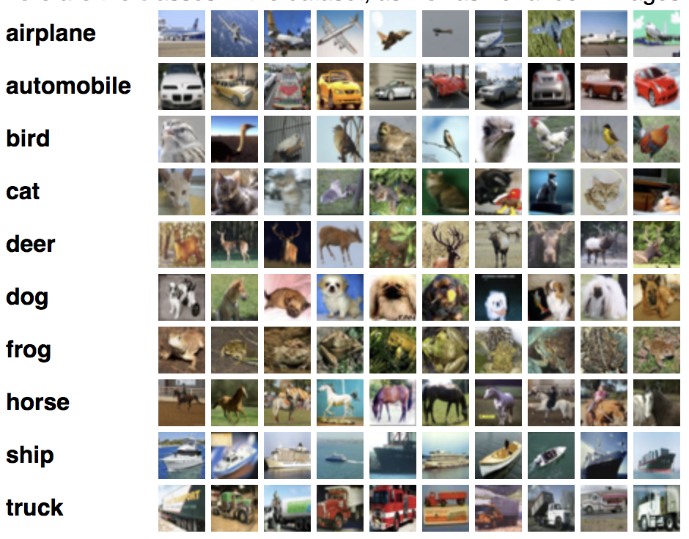
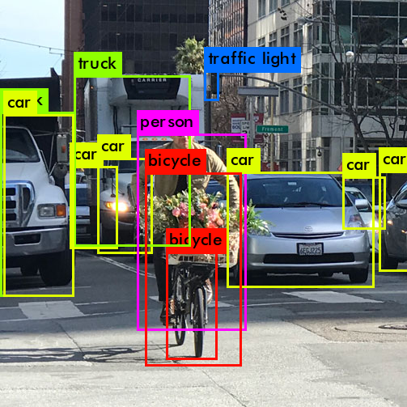
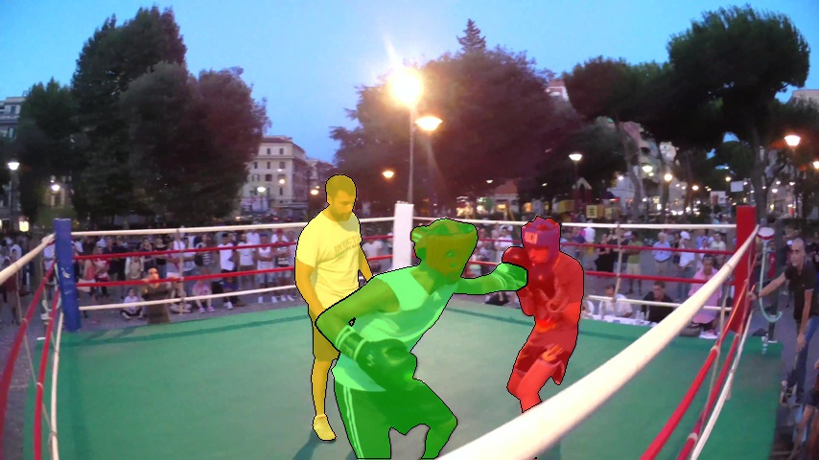
Introduction
Image classification
Object detection
Object segmentation
Assign a label to every pixel in an image
Detect instances of semantic objects of a certain class
Categorize image into one of several classes
3

Slide 4
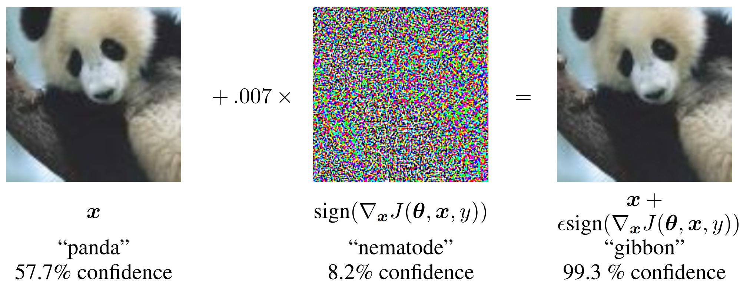
Problem Definition
Deep Networks are vulnerable to adversarial attacks
This article presents the first comprehensive survey on adversarial attacks on deep learning in computer vision.
Adversarial example
Original image
Adversarial perturbation
Goodfellow, Ian J., Jonathon Shlens, and Christian Szegedy. "Explaining and harnessing adversarial examples." arXiv preprint arXiv:1412.6572 (2014).
4

Slide 5
Outline
Introduction
Example of Adversarial Attacks
Real World Adversarial Attacks
Existence of Adversarial Attacks
Defenses of Adversarial Attacks
Conclusion and Review
5

Slide 6
Adversarial Attacks Examples
(table 1 at p7)
6

Slide 7
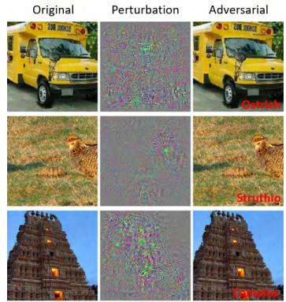
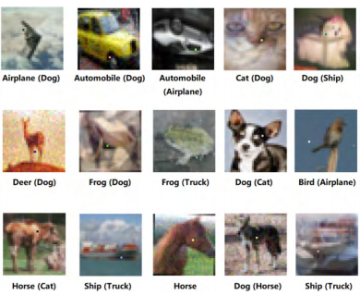
Adversarial Attacks On Classification/Recognition Tasks
Black Box Attacks:
One Pixel Attack
White Box Attacks:
Box-constrained L-BFGS
(Figure 2 at p3)
(Figure 3 at p5)
7

Slide 8
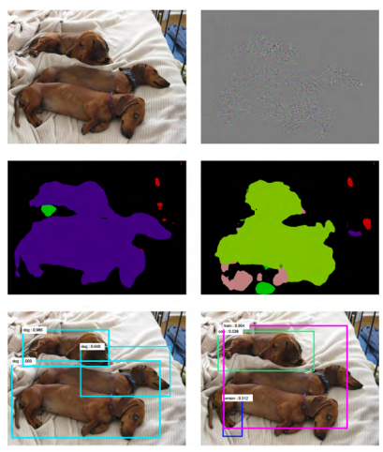
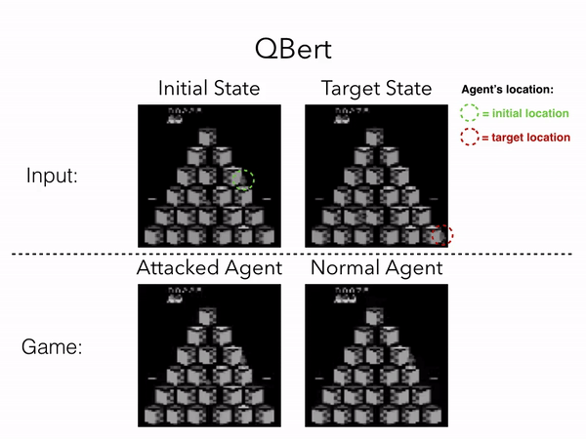
Adversarial Attacks Beyond Classification/Recognition
Attacks on semantic segmentation & object detection (using FCN & RCNN)
Attacks on deep reinforcement learning
Purpose: lure the agent to a designated state
Clean image
Perturbation 10x
Normal segmentation
Fooled segmentation
Detection result
Detection result
(Figure 4 at p8)
Lin, Yen-Chen, et al. "Tactics of adversarial attack on deep reinforcement learning agents." arXiv preprint arXiv:1703.06748 (2017).
5
8

Slide 9
Outline
Introduction
Example of Adversarial Attacks
Real World Adversarial Attacks
Existence of Adversarial Attacks
Defenses of Adversarial Attacks
Conclusion and Review
9

Slide 10
Adversarial Attacks In The Real World
In real-world, images captured by cameras are changing as a result of angle, illumination, etc., so adversarial examples shouldn’t be a problem?
10

Slide 11
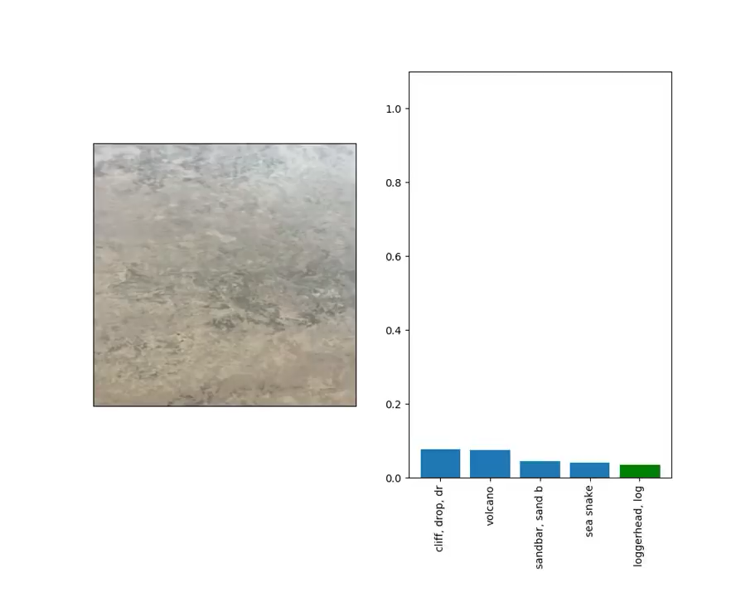
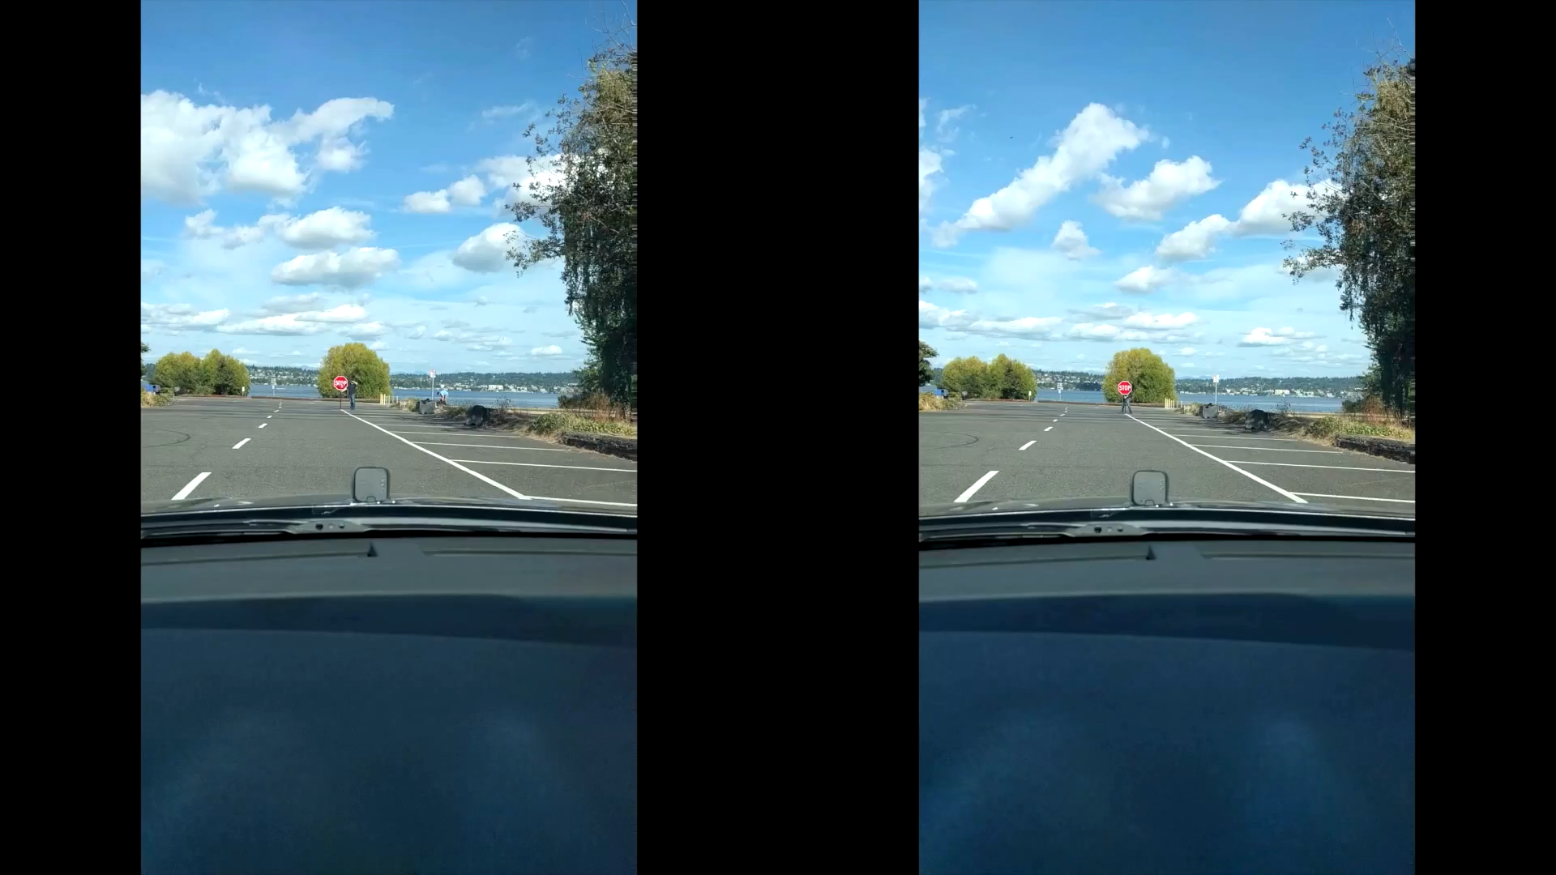
Road sign with stickers [1]
Generic Adversarial 3d Objects [2]
[1] I. Evtimov et al. (2017). ‘‘Robust physical-world attacks on deep learning models.’’ [Online]. Available: https://arxiv.org/abs/1707.08945
[2] A. Athalye, L. Engstrom, A. Ilyas, and K.Kwok. (2017). ‘‘Synthesizing robust adversarial examples.’’ [Online]. Available: https://arxiv.org/abs/1707.07397
11

Slide 12
Outline
Introduction
Example of Adversarial Attacks
Real World Adversarial Attacks
Existence of Adversarial Attacks
Defenses of Adversarial Attacks
Conclusion and Review
12

Slide 13
The Existence Of Adversarial Examples
Adversarial instability of the classifiers
Large space and high dimensionality of adversarial examples
Boundary tilting perspective
Prediction uncertainty and evolutionary stalling of training cause adversaries
Correlation between accuracy and adversarial robustness
13

Slide 14
Outline
Introduction
Example of Adversarial Attacks
Real World Adversarial Attacks
Existence of Adversarial Attacks
Defenses of Adversarial Attacks
Conclusion and Review
14

Slide 15
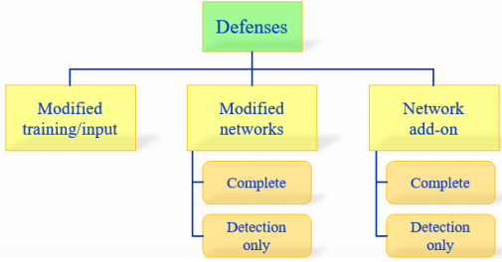
Defenses Against Adversarial Attacks
Modify Training/Input
Brute-force adversarial training
Data compression
Modify Networks
Complete Defense:
Input Gradient Regularization/Masking
Defensive Distillation
Detection Only Approaches:
SafetyNet
Detector subnetwork
(Figure 9 at p13)
15

Slide 16
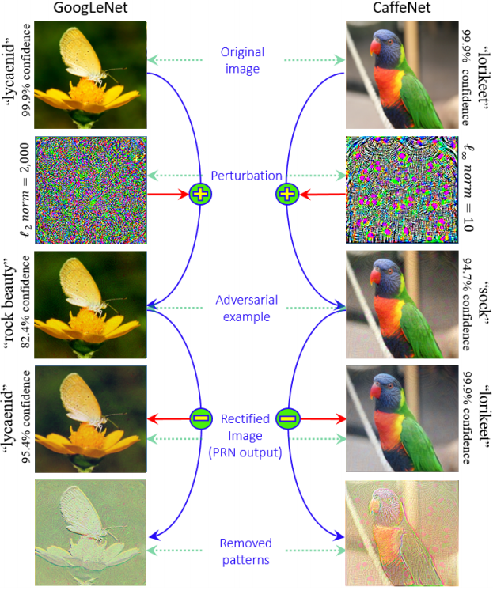
Defenses Against Adversarial Attacks
Network Add-ons
Complete Defense:
Perturbation Rectifying Network
Detection Only approaches:
Feature Squeezing
MagNet
N. Akhtar, J. Liu, and A. Mian. (2017). ‘‘Defense against universal adversarial perturbations.’’ [Online]. Available: https://arxiv.org/abs/ 1711.05929
(Figure 10 at p16)
16

Slide 17
Outline
Introduction
Example of Adversarial Attacks
Real World Adversarial Attacks
Existence of Adversarial Attacks
Defenses of Adversarial Attacks
Conclusion and Review
17

Slide 18
Conclusion
The threats exist in both cyberspace and physical world
Adversarial vulnerability is a general phenomenon
Reasons of adversarial vulnerability need more investigation
Deep learning will have considerable robustness in the future
18

Slide 19
Review
Strength
This article presents a comprehensive survey on adversarial attacks on deep learning in computer vision.
Weakness
Lack of showing the comparison of performances of different defense categories
Should have included more summary tables to have a better visualization.
19

Slide 20
Thank you!

